Slide 1

Game Presentation
By Émilie Mayodon and Akash Singh

Slide 2
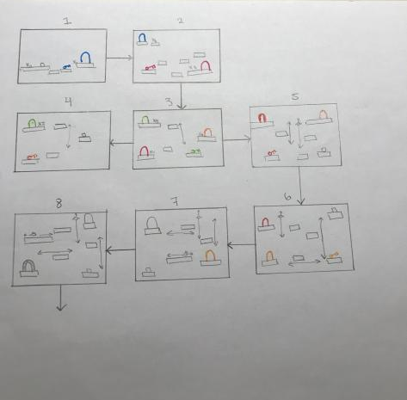
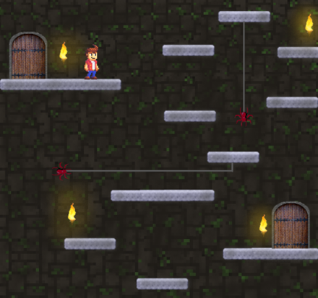
Executive Summary and Level Design
The setting in the game will take place in an underground dungeon under a presumably haunted castle in Scotland, where the crypt will have brown, brick walls with moss, and the platforms will be made of grey concrete.
This game lets you jump, find clues and keys that enrich the story all while being pressured by the clock.
Many young gamers find interest in platforming games; Blitz Breakout offers the latter which targets players that come within the range of 13 to 30 years of age who represent roughly 32% of gamers.

Slide 3
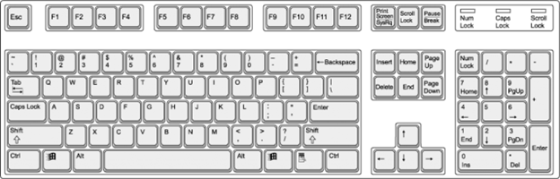
Controls
Move to the left
Move to the right
Interact with items
Jump

Slide 4


Individual Tasks
Implement core mechanics (jumping, picking up items, moving)
Music (soundtrack, sound effects)
Enemies (spiders, rats, pits)
Moving platforms (horizontal and vertical)
Backgrounds (images, prop images)
Transitions (doors and keys mechanic)
Hearts (three lives)
Timer (limited time)

Slide 5


Slide 6
Learnings
Right:
Same page for the game direction
Slowly solve all the problems
Wrong:
Github always had conflicting files, had to create many branches
Could not merge properly
Greenfoot made our PCs slower and kept crashing

